Slide 1
The RIPE Programme Committee
RIPE 76
Marseille, France

Slide 2
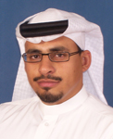
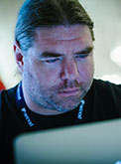
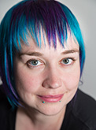
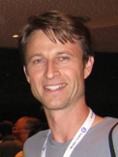
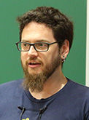
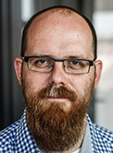
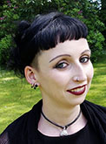
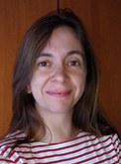
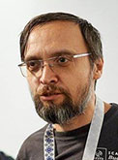
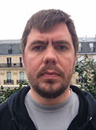
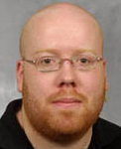
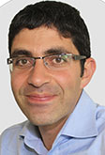
The RIPE Programme Committee
Osama Al-Dosary
MENOG Repr.
Jan Žorž
SEE Repr.
Leslie Carr
Benno Overeinder
Peter Hessler
Ondřej Surý
Simon Muyal
Host Repr.
Khalid Samara
Franziska Lichtblau
Maria Isabel Gandía
Dmitry Kohmanyuk
Pavel Lunin
ENOG Repr.
Brian Nisbet
WG Repr.

Slide 3
Plenary, Tutorials, BoFs
Plenary programme (Mon, Tue, Fri)
16 plenary presentations
9 lightning talks
Tutorials
Monday morning tutorials (9:00–11:00)
BoFs/workshops
Evening sessions (18:00–19:00)
Rate the talks, tutorials and BoFs!

Slide 4
RIPE PC Elections
Two PC seats up for election (every RIPE meeting)
Nominations open until Tuesday, 15:30
email nominations to pc@ripe.net
Candidates can present themselves at the start of the Tuesday, 16:00 session
RIPE PC online voting (w/ RIPE NCC Access)
from Tuesday, 16:00
until Thursday, 17:30

