Slide 1
A modern chatbot approach
for accessing RIPE Database
Database WG | Marseille | 16th March 2018 | v0.1.5 | Copyright © aiONfire GesbR | All rights reserved

Slide 2
RIPE Database is very powerful
Notes:
Problem
Allocations and assignments of IP address space
Assignments of Autonomous System Numbers (AS Numbers)
Reverse DNS registrations
Contact information
Routing policy information (in the Internet Routing Registry)

Slide 3
There are different query methods
Notes:
Problem
Using the web interface on the RIPE NCC website
Using telnet on port 43
Using a whois client, included in most UNIX-like distributions
Using the RESTful API

Slide 4
BUT you need some skills …
Notes:
Problem

Slide 5
… is this really necessary?
Notes:
Problem

Slide 6
Let‘s use janus.cloud technology for simplification
Notes:
Solution

Slide 7
Hands on - examples

Slide 8
Just type in - what you want to know

Slide 9
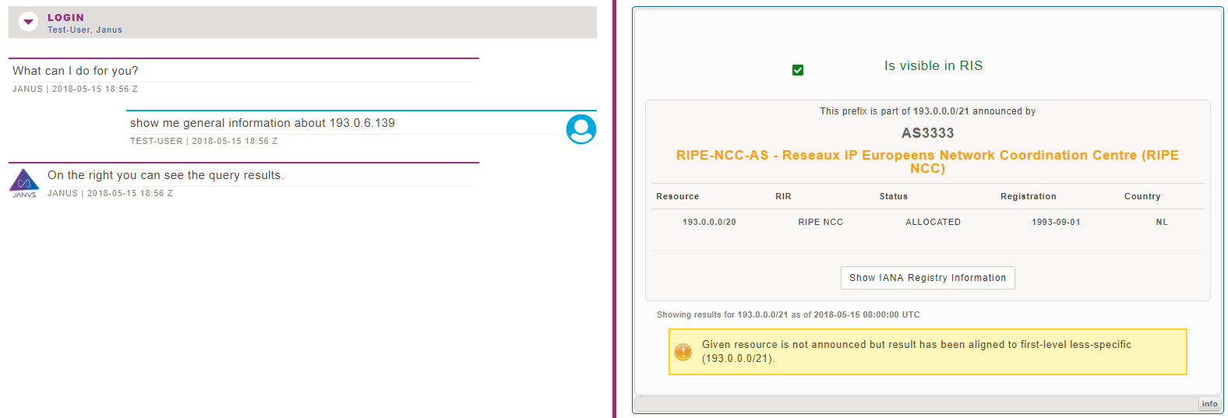
Notes:
Solution
Without knowing all the database details

Slide 10
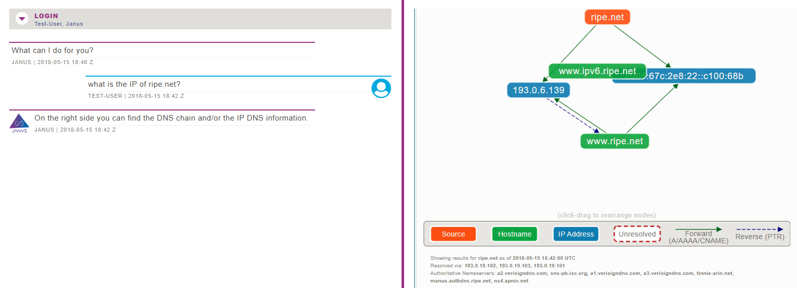

Slide 11
How does that work on the technical side
Notes:
Mockup 2

Slide 12
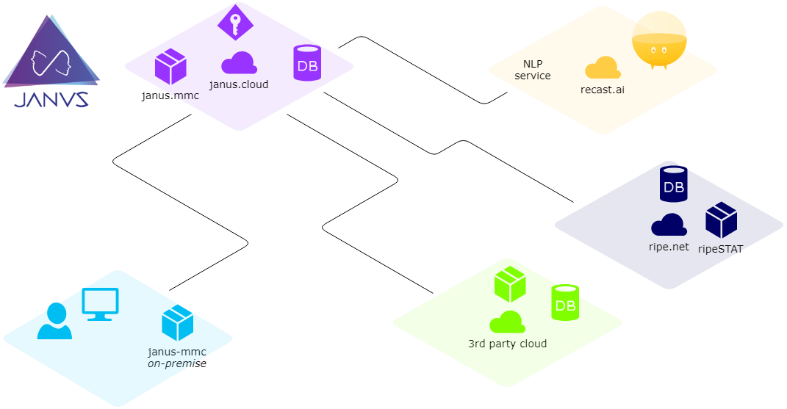

Slide 13
Try-out, please
visit https://janus.cloud
fill-out waiting list form
we supply everything you need to you
any kind of feedback is welcome
Notes:
Mockup 2

Slide 14
Laurenz
Wagner
lw@janus.cloud
https://janus.cloud
Notes:
Q&A + contact Details

