Slide 1
Measuring routing (in)security
Disclaimer – this is not a scientific research
Andrei Robachevsky
manrs@isoc.org

Slide 2
Why to measure?
Provide a factual state of routing security as it relates to MANRS
Support the problem statement with data
Demonstrate the impact and progress
Network, country, region, over time
Inform MANRS members about their degree of commitment
Improve reputation and transparency of the effort
Automate the process
Make it more comprehensive and consistent
Reduce the load
Allow preparation (self-assessment)

Slide 3
How to measure?
Transparent.
The measurements should use publicly available data sources and the code should be made open source.
Passive
No cooperation is required from a network.

Slide 4
MANRS Actions
Filtering Prevent propagation of incorrect routing information
Ensure the correctness of your own announcements and announcements from your customers to adjacent networks with prefix and AS-path granularity
Anti-spoofing Prevent traffic with spoofed source IP addresses
Enable source address validation for at least single-homed stub customer networks, their own end-users, and infrastructure
Coordination Facilitate global operational communication and coordination between network operators
Maintain globally accessible up-to-date contact information in common routing databases
Global Validation Facilitate validation of routing information on a global scale
Publish your data, so others can validate

Slide 5
What can we measure?

Slide 6
Action 1: Filtering
Metric | Description
M1 | route leak by the AS
M2 | route hijack by the AS
M1C | route leak by a customer and not filtered by the AS
M2C | route hijack by a customer and not filtered by the AS
M3 | announcement of bogon prefixes
M4 | announcement of bogon ASNs (unallocated/reserved)

Slide 7
Action 2: Anti-spoofing
Metric | Description
M5 | spoofable IP blocks
M5C | spoofable IP blocks of client AS’es

Slide 8
Action 3: Coordination
Metric | Description
M8 | contact registration (RIR, IRR, PeeringDB)

Slide 9
Action 4: Facilitate global validation
Metric | Description
M6 | policy documented in an IRR (aut-num w/import/export, as-set)
M7IRR | registered routes (% of routes registered)
M7RPKI | valid ROAs (% of routes registered)
M7CIRR | registered customer routes (% of routes registered)
M7CRPKI | valid ROAs for customer routes (% of routes registered)

Slide 10
How to calculate? E.g. M2 - route hijack by an AS?
Impact
M2 = f(#prefixes, address span, duration)
Not all prefixes are equal
Does size matter?
Hard to normalize/define thresholds
Conformity
M2 = f(#distinct incidents, resolution time)
# incidents and resolution time show the degree of negligence
What is an incident?
Finite number – easy to define thresholds

Slide 11
Events and incidents. E.g. M2C
Weight
Events are weighted depending on the distance from the culprit
M1C (ASPATH-1), 0.5*M1C(ASPATH-2), 0.25*M1C(ASPATH-3)… min 0.01
Incident
Events with the same weight that share the same time span are merged into an incident.
Duration
Non-action is penalized
< 30mins -> 0.5 * weight
< 24hours -> 1.0 * weight
< 48hours -> 2.0 * weight

Slide 12
Example: direct customer hijacks prefixes
M2C = 0.5 + 1.0 + 2.0 = 3.5

Slide 13
Feedback and ideas are welcome!
robachevsky@isoc.org

Slide 14
Backup slides

Slide 15
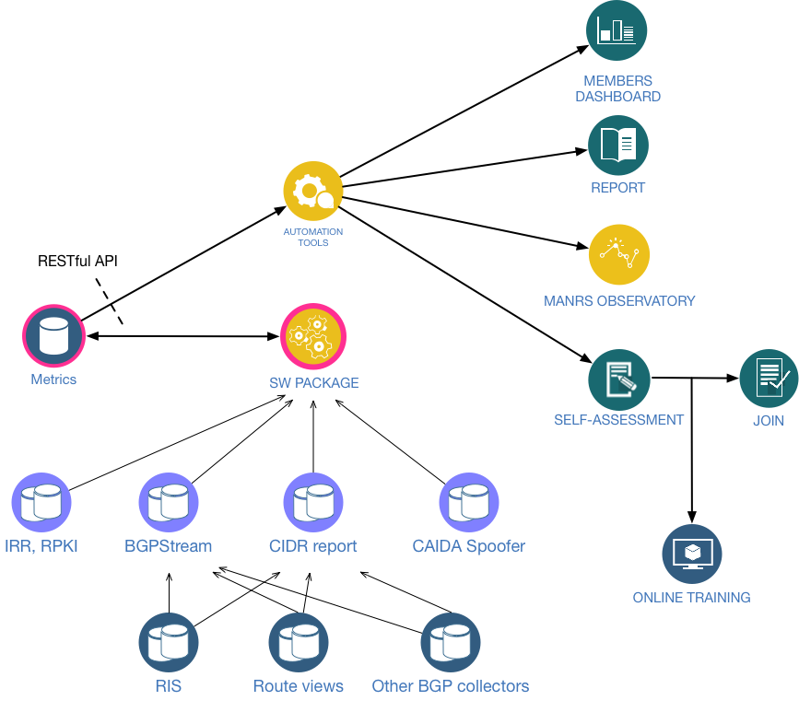
How does it all fit together?

Slide 16
MANRS@isoc.org

