Slide 1
Anti Spoofing. Reboot.
Alexander Azimov <aa@qrator.net>

Slide 2
IP Spoofing
Attacks on TCP stack;
TCP floods (SYN, ACK,…);
Reflection Attacks;
Amplification Attacks.

Slide 3
DDoS Amplifiers
Source: Qrator Labs annual report 2017

Slide 4
BCP84: uRPF
https://tools.ietf.org/html/bcp84
Strict mode;
Feasible mode;
Loose mode.

Slide 5
Strict Mode
Ingress Traffic
Egress Traffic
Provider C
178.248.232.0/24
Provider A
Provider B
178.248.232.0/24
178.248.232.0/24
Customer
Rule: incoming interface = interface for the best route for SRC_IP

Slide 6
Loose Mode
Ingress Traffic
Egress Traffic
Provider C
178.248.232.0/24
Provider A
Provider B
178.248.232.0/24
178.248.232.0/24
Customer
Rule: there is a route for SRC_IP

Slide 7
Feasible Mode
Ingress Traffic
Egress Traffic
Provider C
178.248.232.0/24
Provider A
Provider B
178.248.232.0/24
178.248.232.0/24
Customer
Rule: incoming interface = interface for the best route for SRC_IP

Slide 8
Feasible Mode
Ingress Traffic
Egress Traffic
Provider C
178.248.232.0/24
Provider A
Provider B
178.248.232.0/24
Customer
Rule: incoming interface = interface for the best route for SRC_IP

Slide 9
Problem Statement
A distance-vector protocol isn't the best way to propagate availability information.

Slide 10
Option №1: New SAFI

Slide 11
GRACEFUL_SHUTDOWN
Ingress Traffic
Egress Traffic
Provider C
178.248.232.0/24
178.248.232.0/24
Provider A
Provider B
178.248.232.0/24
178.248.232.0/24
GRACEFUL_SHUTDOWN
Customer
A new transit well-known community that sets LOCAL_PREF to 0.

Slide 12
GRACEFUL_SHUTDOWN
Ingress Traffic
Egress Traffic
Provider C
178.248.232.0/24
178.248.232.0/24
GRACEFUL_SHUTDOWN
Provider A
Provider B
178.248.232.0/24
178.248.232.0/24
GRACEFUL_SHUTDOWN
Customer
A new transit well-known community that sets LOCAL_PREF to 0.

Slide 13
GRACEFUL_SHUTDOWN
Ingress Traffic
Egress Traffic
Provider C
178.248.232.0/24
178.248.232.0/24
GRACEFUL_SHUTDOWN
Provider A
Provider B
178.248.232.0/24
178.248.232.0/24
GRACEFUL_SHUTDOWN
Customer
A new transit well-known community that sets LOCAL_PREF to 0.

Slide 14
Feasible Mode + Hacking
Ingress Traffic
Egress Traffic
Provider C
178.248.232.0/24
Provider A
Provider B
OK
178.248.232.0/24
178.248.232.0/24
GRACEFUL_SHUTODWN
NO-EXPORT
Customer
Works only for stub ASNs.
But it’s more than 85% of entire Internet!

Slide 15
Option 2: Hacking
GRACEFUL_SHTUTDOWN + NO-EXPORT communities can be used as informational message for directly connected peers.
Positive:
We do not need to change specification;
We do not need to ship new software;
We solve problem for majority of ISPs;
Negative:
A lot of work with customers is required;

Slide 16
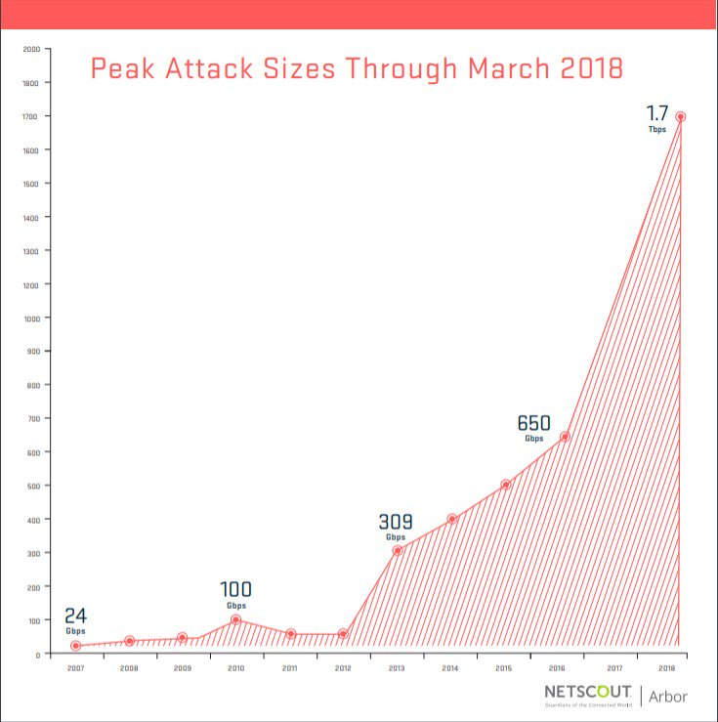
Option 3: Do Nothing.
But are you prepared?

Slide 17
http://etc.ch/kfR6/

